Slide 1

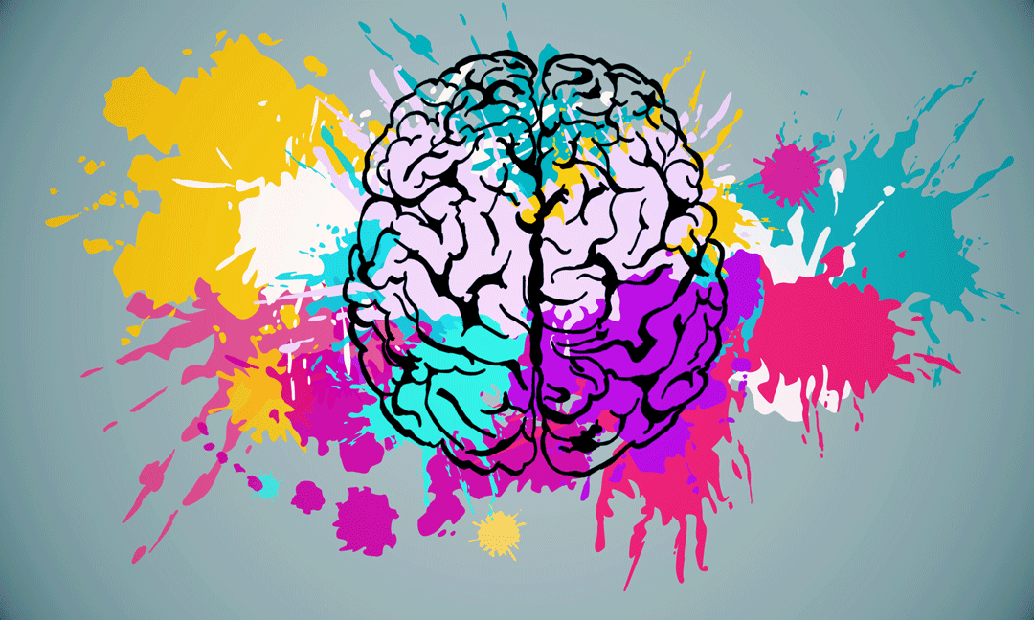

Managing
People
Jose Herreria
Notes:
Thanking the GSNA and Alyssia for inviting me to present to you all today.
I’m a little rusty, dust off some of the cobwebs. You may see me peeking at my screen from time to time, that’s just checking my notes to make sure I don’t miss anything.
(PANTS)
I was a corporate trainer for 10 years, systems and procedures training, as well as soft skills. I’m not a psychologist or mentalist.
Normally this presentation is about half the day, but I’m going to cram it into 45 mins to lets go!!
2 min

Slide 2
Managing
Personalities
Jose Herreria
Notes:
4 min
PEOPLE ARE EASY TO MANAGE, JUST THINK OF CATTLE. A COWBOY CORRALS THEIR CATTLE BY BARKING AT THEM A FEW TIMES. LIKE KIDS RIGHT.
NOW IMAGINE IF THOSE CATTLES HAD PERSONALITES. HOW WOULD BARKING WORK THEN.
ITS IMORTANT TO KNOW THAT WE MANAGE PERSONALITES RATHER THAN JUST PEOPLE.
QUESTION, SHOW OF HANDS, IS YOUR OWN PERSONALITY IMPORTANT IN MANAGING OTHERS.

Slide 3
What are you going to get out of today!
  What is your personality, in color!
  Have some fun.!!!
  There are 22 slides in 45 minutes.
  You will have the knowledge to apply what you have learned.
  Please make sure your neighbor is comfortable!
Notes:
6 min

Slide 4

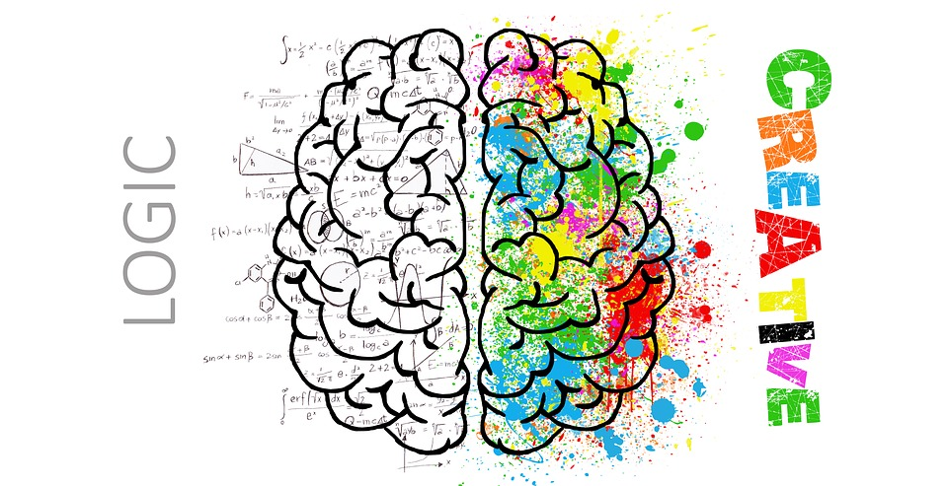

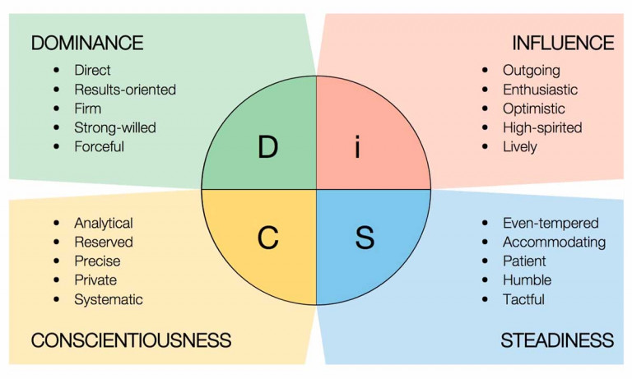
Ancient Subject !!
Hippocrates
Wundt
Freud
Jung
Myers-Briggs
Notes:
ASKING WHO I AM IS OFTEN TIMES MORE VALUABLE THAN AKSING WHO YOU ARE.
SELF ACTUALIZATION – WHICH IS THE PINNACLE OF MASLOWS HIERACHY – AS HUMANS WE NEED THINGS
FOOD WATER AND SHELTER
SAFETY AND SECURITY
LOVE AND BELONGING
ESTEEM – BOTH SELF AND THOSE AROUND YOU
BE ALL THAT YOU CAN BE
WE’VE PROBABLY HEARD OF SOME OF THESE INDIVIDUALS AND THE WORK THEY HAVE DONE IN THE FIELD OF HUMAN PSYCOLOGY AND BEHAVIOUR
Many different methods and interpretations…today we are going to break things down into two buckets to make it more digestible if you will
8 Min

Slide 5
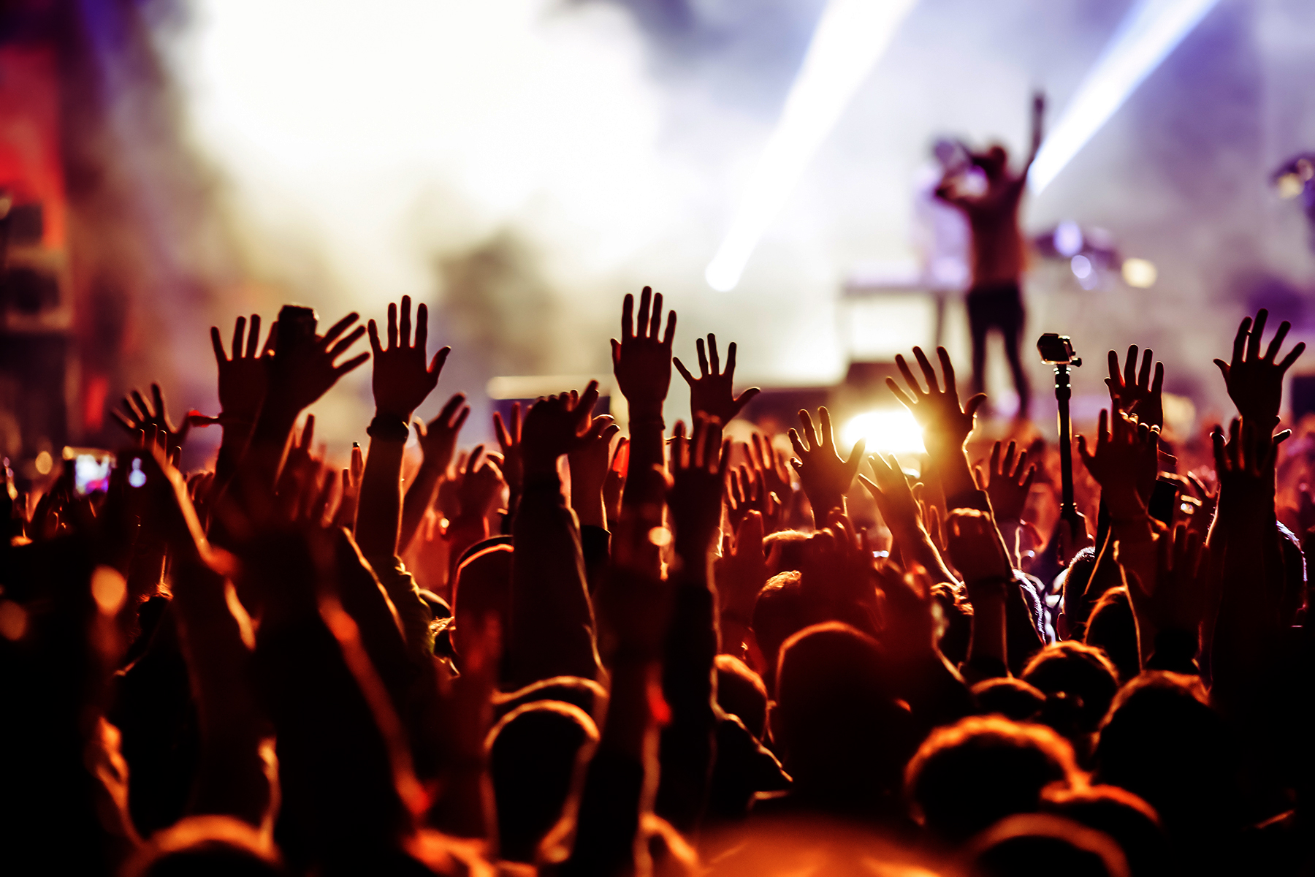

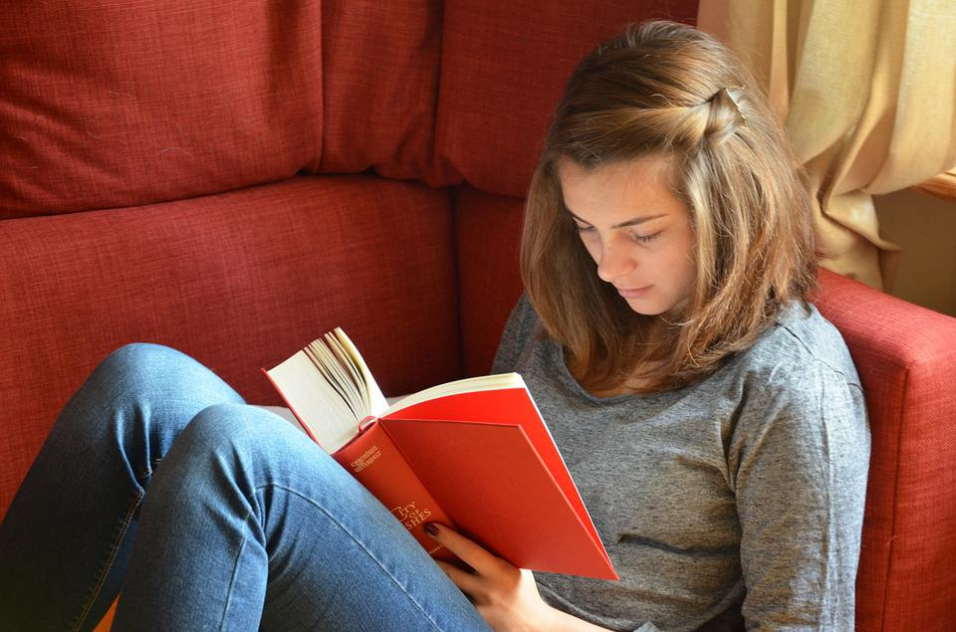
ENERGY
Notes:
LET'S LOOK AT THESE PICTURES AND IN YOUR MIND THINK ABOUT WHAT YOU THINK THESE TWO REPRESENT.
CONCERT
STUDENT
CROWD
QUIET
THEY REPRESENT YOUR ENERGY SOURCE…I’LL EXPLAIN THAT IN A MINUTE
NOW START THINKING ABOUT WHICH OF THESE YOU ASSOCIATE YOURSELF WITH. IS IT THE LOUD CONCERT SCENE OR THE QUITE BOOK ON A COUCH..
10

Slide 6
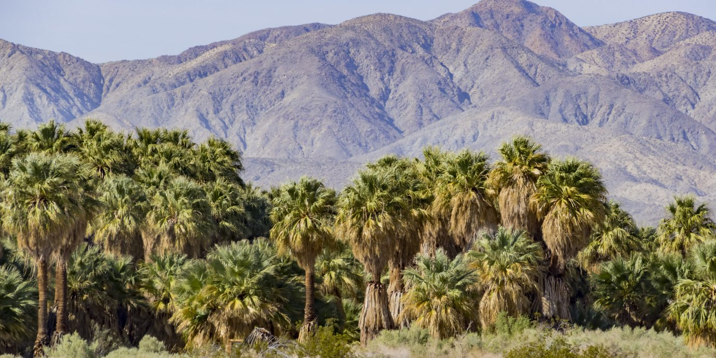
Notes:
11
Look at this serene mountain scene… looks peaceful and somewhat secluded.

Slide 7
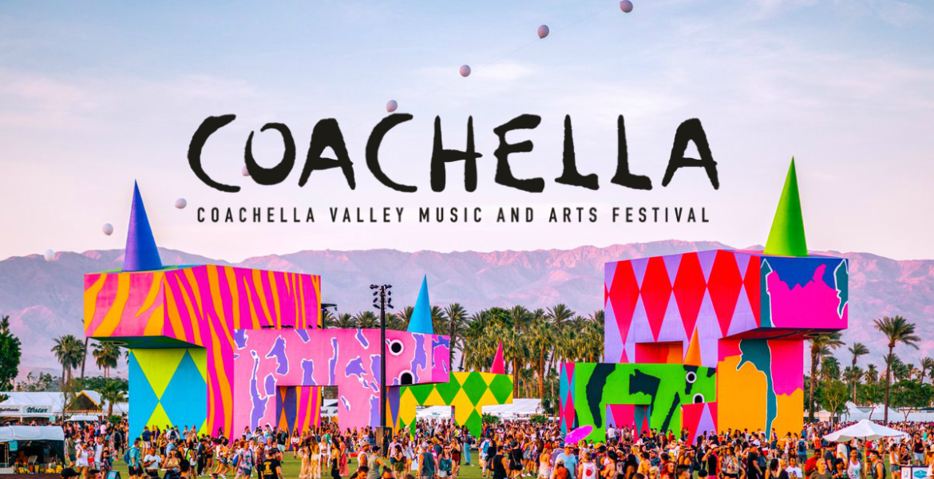
Notes:
12
That same valley in the picture before also hosts one of the biggest music and art festivals in the world.
About half of you were already imagining a nice quiet walk taking in the scenery possible a sunset. The other half were like ok, mountains nice, sure.
The other half of the room might have gotten more excited when this festival picture came up. Saying, wow that looks like it could be fun.
Some of you may have been indifferent by looking at either of the images.

Slide 8
INTROVERT
EXTROVERT
“Only a sith deals in absolutes”
OBI-WAN KENOBI
Notes:
14
Our energy source is really categorized into two often missused or misunderstood terms
EXTROVERT: ENERGY SOURCE IS EXTERNAL
INTROVERT: ENERGY SOURCE IS INTERNAL

Slide 9
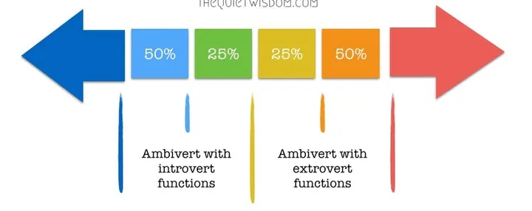
AMBIVERT
INTROVERT
EXTROVERT
Notes:
AMBIVERT: a person whose personality has a balance of extrovert and introvert features.
16

Slide 11
Notes:
20
Bucket #1, was that simple scale of Introvert and Extrovert. Important to understand that because again our energy source is a very powerful component of our personality.
Bucket#2 is where we will identify our personality with a color.
With all the methods that exist out there, I have found that the color method provides the simplest way to help identify our personality and those around us.

Slide 12

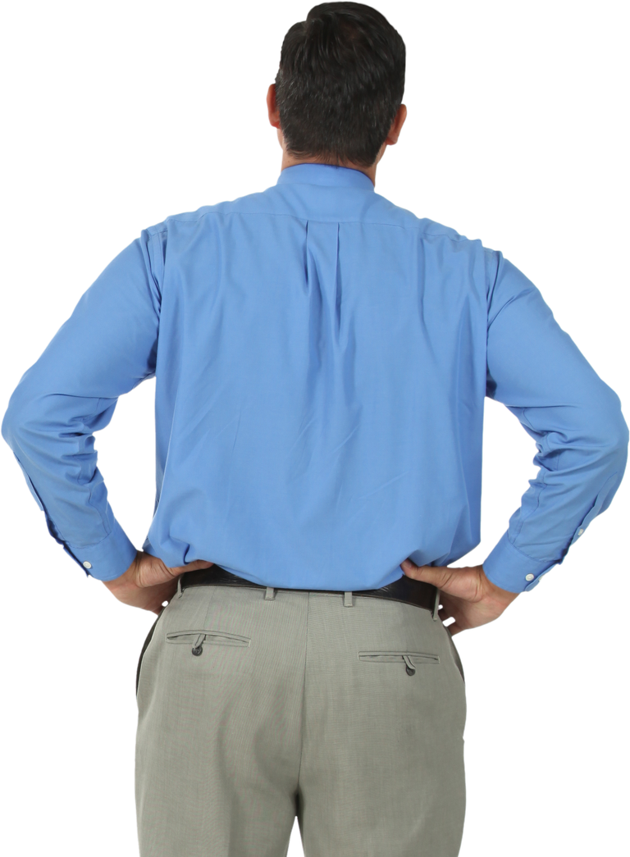
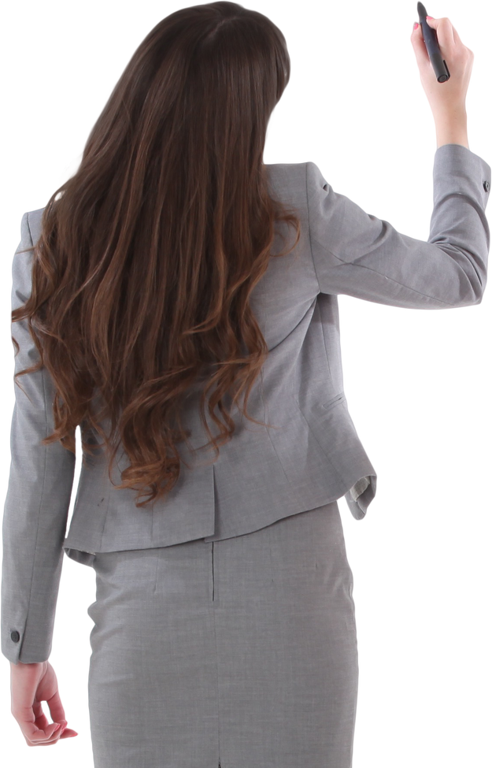
Sample 2
This isn’t fun!!
Oh no!
Analysis Paralysis
We are wired in our own way!
Everyone has a personality type they gravitate to. It
is those differences in
personality that allow
us to thrive or fail.
If we know how to see
personality types by color
we can find better
collaboration and better
outcomes!

Slide 13
OUTGOING
GOLD
ORANGE
TASK
ORIENTED
PEOPLE
ORIENTED
GREEN
BLUE
RESERVED

Slide 14

The Organized Gold values belonging, orderliness, responsibility, system productivity, efficiency, fairness, security, stability, duty, tradition and accuracy. You might want to picture them as industrious beavers.
Highest % of total population, nearly half!

Slide 15
Do’s
  Have a plan
  Future Driven
  Stability
  Belonging
  Responsible
  Accountability
  Family
Dont’s
  Surprises
  Change
  Broken Rules
  Isolate
  Inconsiderate
  Chaos
  Excuses

Slide 16
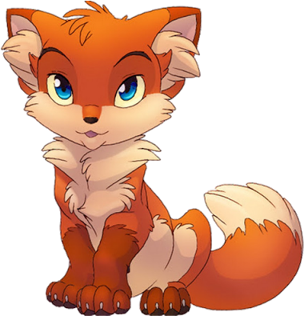
The Resourceful Orange values action, freedom, variety, speed, high impact, agility, precision, excitement, fraternity and spontaneity. You may want to think of them as a fox – ready to turn “on a dime” to seek the next adventure.
A fox does not plan its day. It just goes out
each morning knowing that it has to survive.

Slide 17
Do’s
  Spontaneous
  Action Driven
  Adventurous
  Individuality
  Feel Appreciated
  Creative
  Fast Results
Dont’s
  Rigidity
  Discouragement
  Restriction
  Monotone
  Confrontation
  Quiet Places
  Ignore

Slide 18

The Authentic Blue type appreciates cooperation, teamwork, creativity, individuality, self-actualization, optimism, generosity, relationships, sensitivity, harmony and personal growth. They might be pictured as playful, friendly dolphins.
Blue suggests serenity and depth of feeling.

Slide 19
Do’s
  People
  Emotions
  Optimistic
  Connection
  Feel Appreciated
  Cry Easy
  XOXOXO
Dont’s
  Cold Facts
  Disconnected
  Can’t Help
  Alone
  Aggressiveness
  Conflict
  Uncomfortable

Slide 20

The Inquiring Green appreciates autonomy, privacy, independence, logic, competence, objectivity, ingenuity and future orientation. People often picture them as wise owls.
Logic is the beginning, not the end of wisdom!

Slide 21
Do’s
  Thinking
  The Why
  Challenge
  Competence
  Facts
  Time to Process
  Long Term Goals
Dont’s
  Rush
  Ambiguity
  Secrets
  Basic Tasks
  Large Groups
  Short Term Goals
  Sarcasm

Slide 22
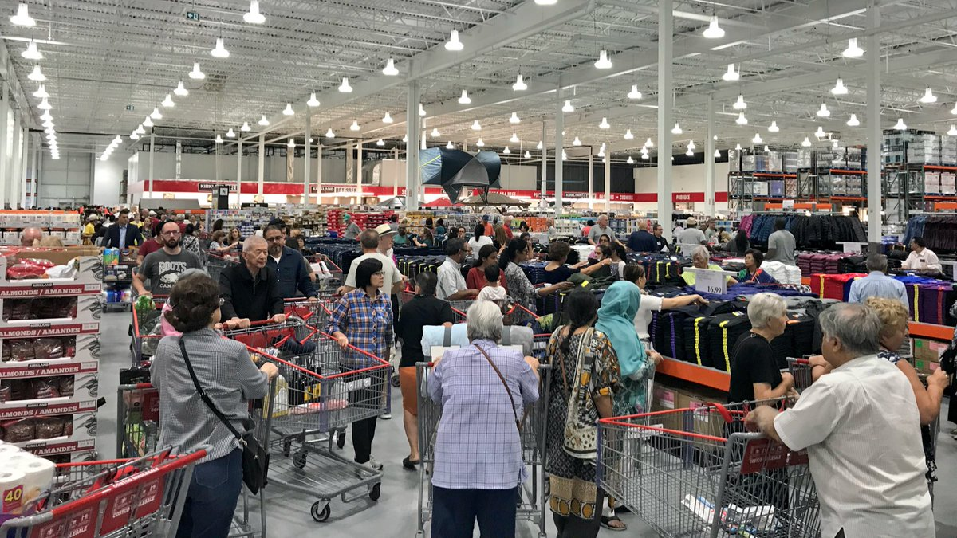
Notes:
19

Slide 23

Thank You!!

